Slide 1

Fighting Hunger with Data in NYC (Bon Appetit!)
Presented by the Lively Leaflets:
Alok Kommajesula, Aparna Potdar, Kevin Crosby, Trevor Prescott, Raj Ray

Slide 2

Are you tired of eating the same foods every day?
If your meal menu runs on repeat, your body might hit a snag: People who eat the same foods over and over again tend to be less healthy than those who strive for variety, suggests recent research in the Journal of Nutrition.
Source:https://www.menshealth.com/nutrition/a19540574/food-variety-health-benefits/

Slide 3

Gathering reviews from multiple sources
Many restaurant review sites offer businesses the ability to pay for the removal of negative reviews
Difficult to accept one source at face value
Since hungry people aren’t known for their patience, we decided to create an aggregate review site that doesn’t require a huge time investment to navigate (“one-stop shopping”)

Slide 4
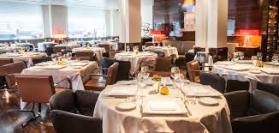
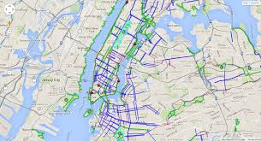

Slide 5
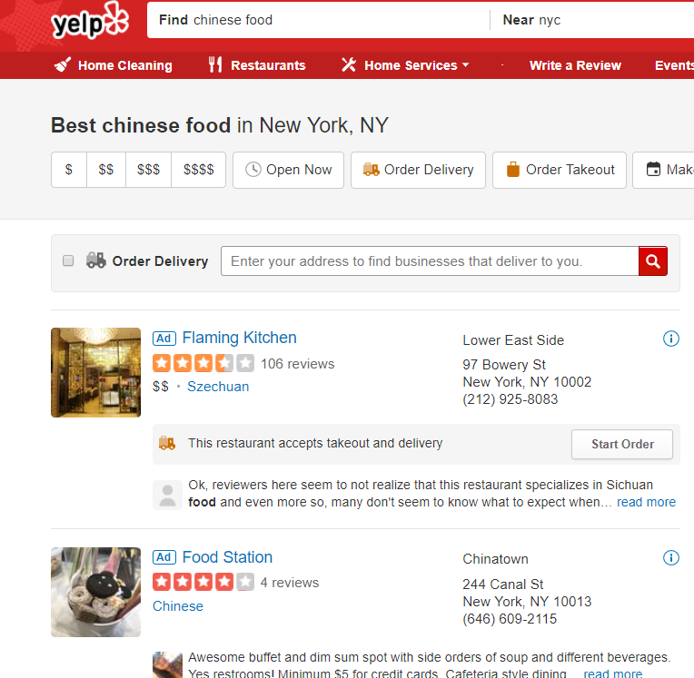
The old way:
Sponsored links(ad) are listed on top, despite often being out of your search range
Requires extremely specific search criteria
Repetitive cycling through pages for each search
More likely to be manipulated by removing negative reviews
Rinse and repeat for various restaurant types, price ranges, ratings, and data sources

Slide 6
LIVE DEMO

Slide 7
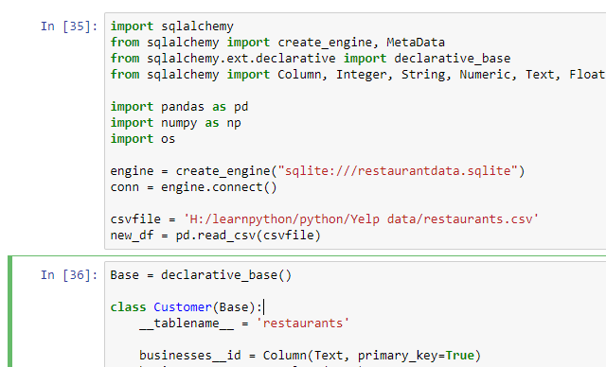



Creating a Database:
First, we gathered data from multiple review sites:
Yelp API
Zomato API
Google Maps API
Using SQL, we created a set of standards and consolidated our data into a SQLite file.

Slide 8
Designing an Interface
With convenience in mind, we designed an interface that focused on three fields
Cuisine Type
Price Point
Aggregate Average Review Rating
We wanted to enable three primary functions
Exploratory restaurant navigation (What should I eat today?)
Overview of nearby restaurants (What does my town have to offer?)
Map of my city with Restaurant results

Slide 9
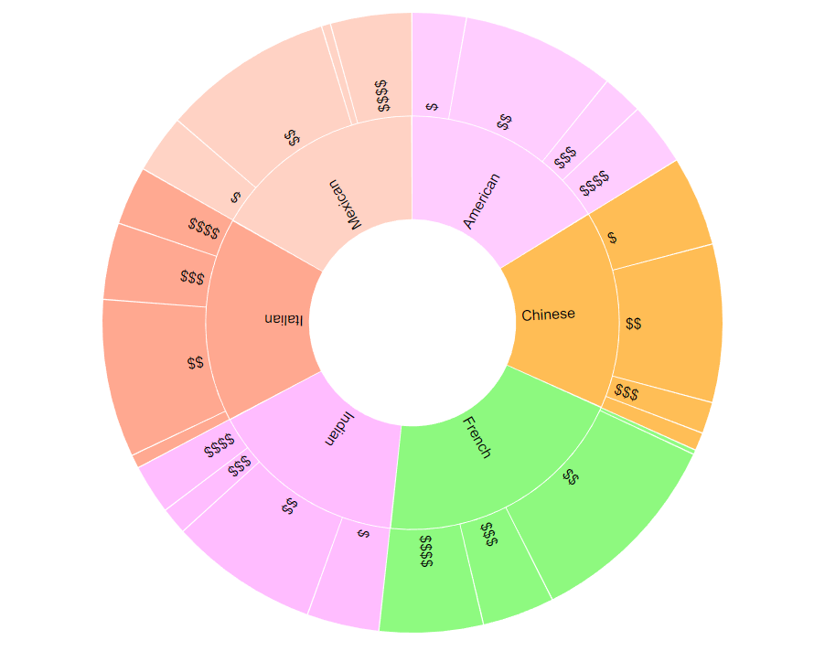
Exploratory Restaurant Navigation

Slide 10
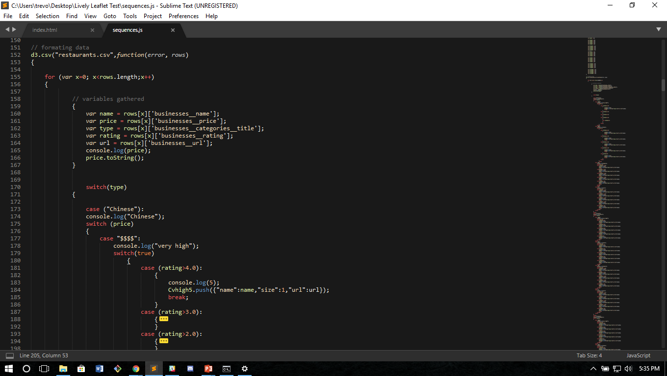
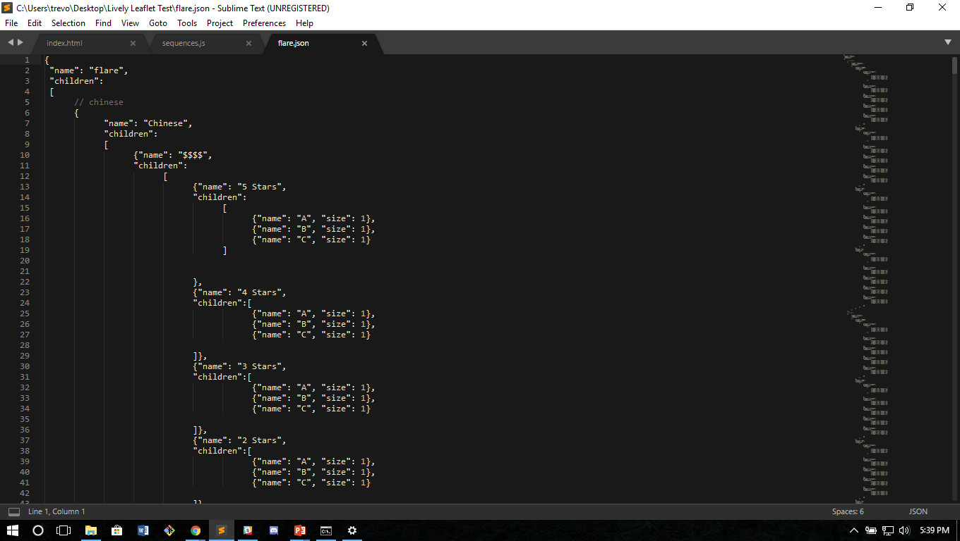
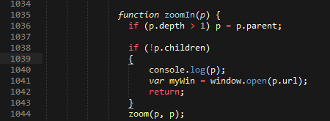
Translating the Data
We utilized a Bi-level Partition code (found here) as the base of our code. Manipulating this code presented 3 unique challenges.
Extracting data from a csv
Formatting it into a usable interface.
Providing onclick functionality to at end of parent-children chain.

Slide 11
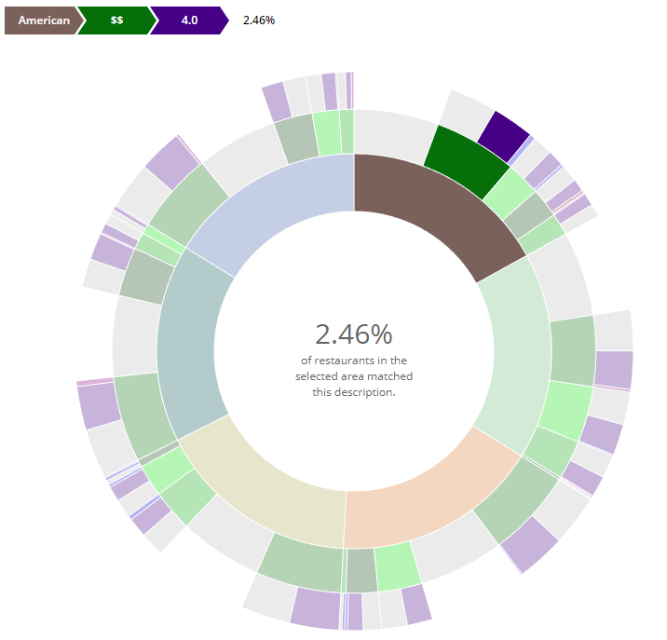
Overview of Nearby Restaurants

Slide 12
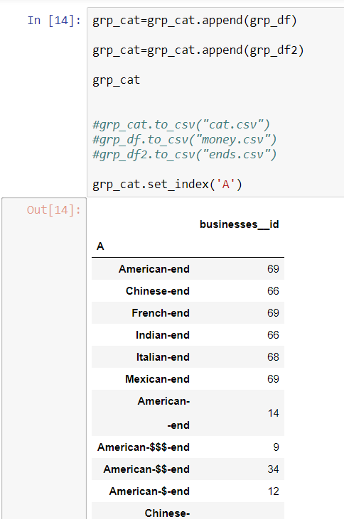
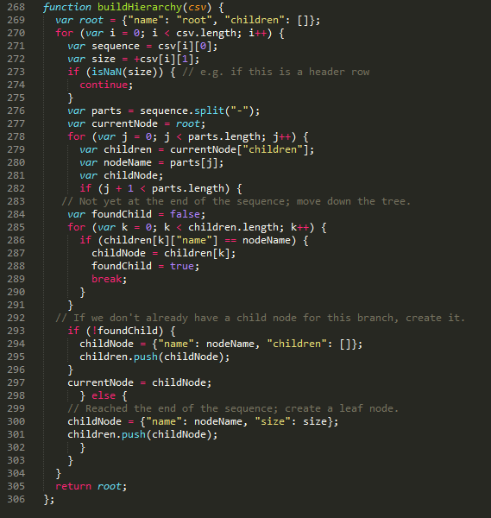
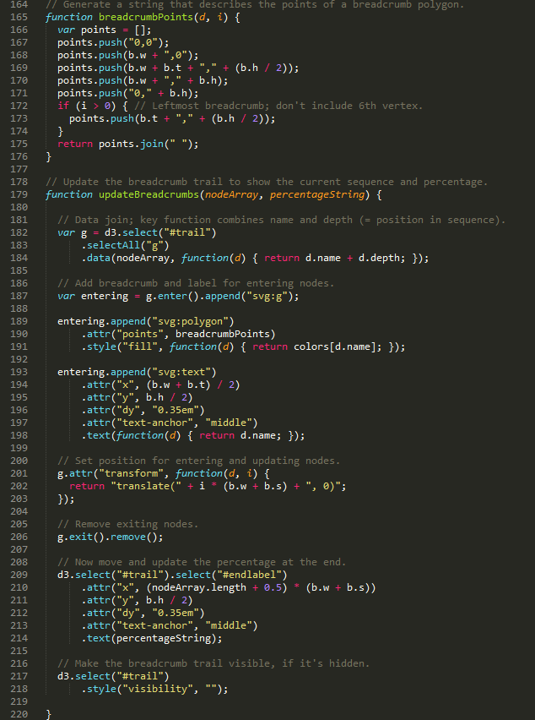
Translating Hierarchy Breadcrumb The Data Builder

Slide 13
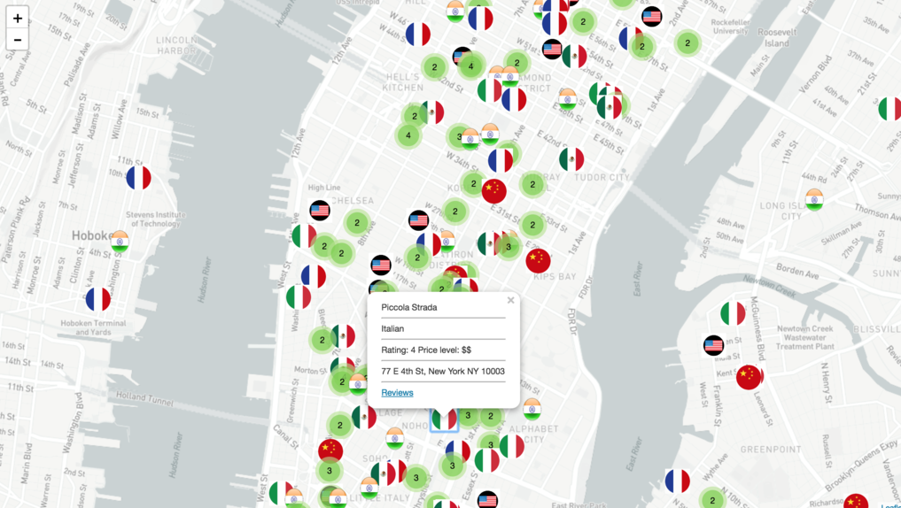
Restaurant Mapping

Slide 14
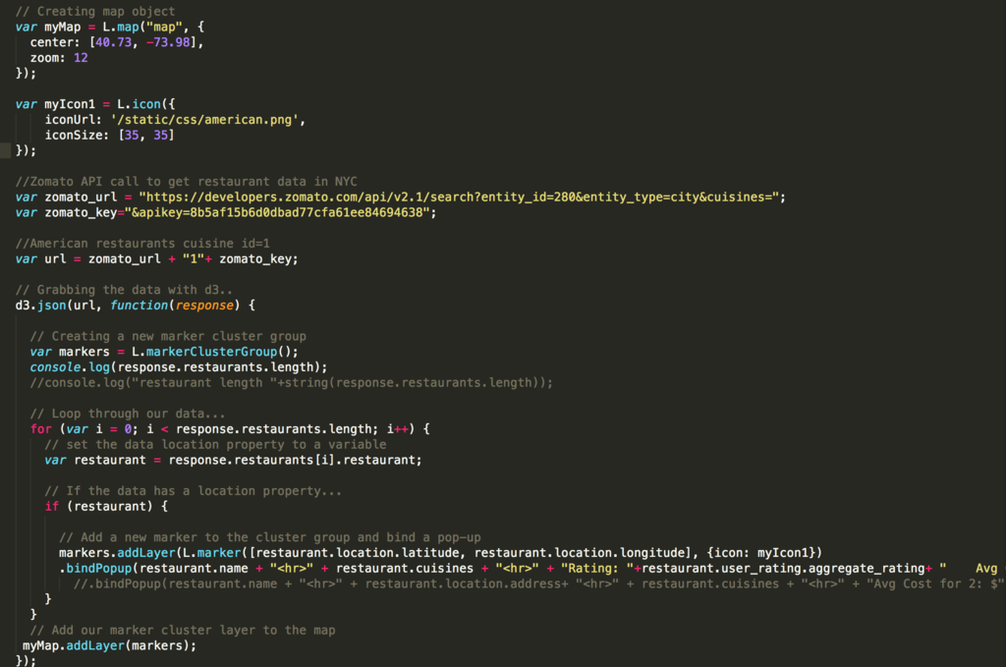
Restaurant Mapping

Slide 15
Moving forward
APIs:
Due to free API access constraints, our volume was limited. Paid APIs would enable us to list significantly more restaurants and areas
Front-End:
Various interface changes could be made to improve aesthetics and user experience
Heroku Deployment:
Due to locally hosted files, the creation of a virtual server was utilized to access local files
Possible mobile device implementation

Slide 16

Thanks for your Time!
Go Lively Leaflets!!

